Slide 1

Telco Customer Churn
Lara Miller
March 23, 2022

Slide 2
What is Telco?
Fictitious telecommunications company offers phone and internet services
Why predict churn?
Costs company 5x more to attain NEW customer than to keep an existing one
Project Goals
Create classification model to predict customer churn
Use model to identify areas within Telco business that could be improved to help retain customers
Notes:
Churn prediction is the detection of which customers are likely to leave a company
Telco is a telecommunication Company that offers phone and internet services in California interested in minimizing its churn rate.
Important because acquiring new customers costs more than retaining existing ones. The general rule of thumb is 5x
Project goals to create a classification model to predict customer churn
Use model to identify areas within Telco business that could be improved to help retain customers

Slide 3
Data
7024 Customers | 25 features
Product and Services
Geographic
City
Zip code
Latitude
Longitude
Demographics
Senior
Dependents
Gender
Churn
Churn (yes, no)
Churn reason
Customer lifetime value
Phone Service
Multiple Lines
Internet Service
Online Security
Online Backup
Device Protection
Tech Support
Streaming TV
Streaming Movies
Contract
Paperless Billing
Payment Method
Monthly Charges
Total Charges
Tenure (months)
Partner
Notes:
Data used for this analysis came from Kaggle
It consists of information on 7024 customers for 25 different features across 4 general categories
Product and Services/ geographic information and demographics of the customer/ and whether a customer churned and why

Slide 4
Process for creating a classification model
Exploratory Data Analysis & Feature Engineering
Model Fitting & Tuning
Model Selection
Feature Importance
Notes:
The first goal of the project was to create a classification model to predict churn. This approach included 4 steps – exploratory data analysis and feature engineering, model fitting and tuning, model selection, and feature importance assessment.
It was iterative where each step informed iterations within the step as well as the next step.

Slide 5
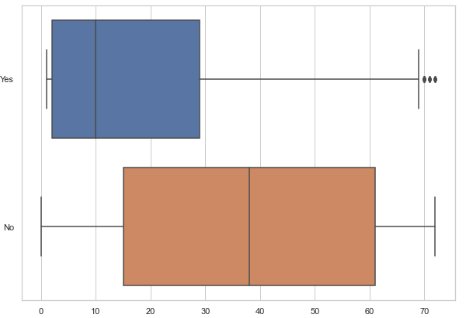
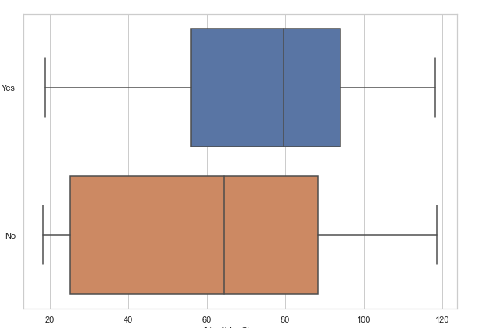
Baseline
Exploratory Data Analysis & Feature Engineering
Model Fitting & Tuning
Model Selection
Feature Importance
Tenure for churned customers lower than for customers who stay
Monthly charges for churned customers much higher than for customers who stay
Churned customer
Non-churned customer
Notes:
I want to start with a brief overview of the baseline model as point of comparison for the final model results
For initial exploratory data analysis, univariate and bivariate analyses on 25 features using boxplots, histograms and countplots
Two key takeaways:
Churn customers have a much shorter tenure with the company…if they are going to leave they usually do it sooner than later
The monthly charges for churned customers are higher

Slide 6
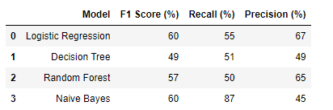
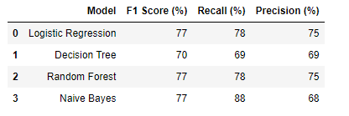
Baseline
No model tuning
Exploratory Data Analysis & Feature Engineering
Model Fitting & Tuning
Model Selection
Feature Importance
Correct imbalance and cross validation
60% to 77%
Notes:
In the initial model fitting and tuning, I addressed target variable imbalance using undersampling and cross validation for train/testing split
I selected 4 model to compare, linear regression and decision tree for their simplicity and ease of explanation, random forest, an ensemble model that in many churn prediction models has performed the strongest, and naïve bayes, a model that often performs well with smaller datasets.
I used f1 score to compare performance
F1 score represents the harmonic mean of recall (% of actual churns) and precision (% of churns predicted that were actually churns)
In the baseline iteration, logistic regression and random forest performing equally

Slide 7
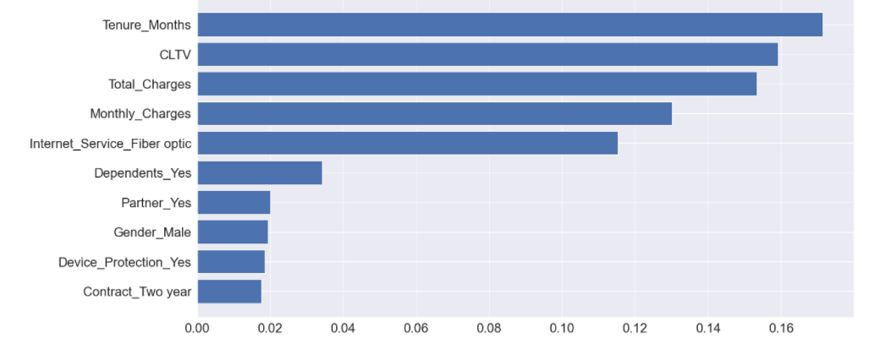
Baseline
Top 5 features
Tenure (months)
Customer lifetime value
Total Charges
Monthly charges
Fiber optic internet service
Exploratory Data Analysis & Feature Engineering
Model Fitting & Tuning
Model Selection
Feature Importance
Notes:
In the last step, look at feature importance to help inform future iterations.

Slide 8
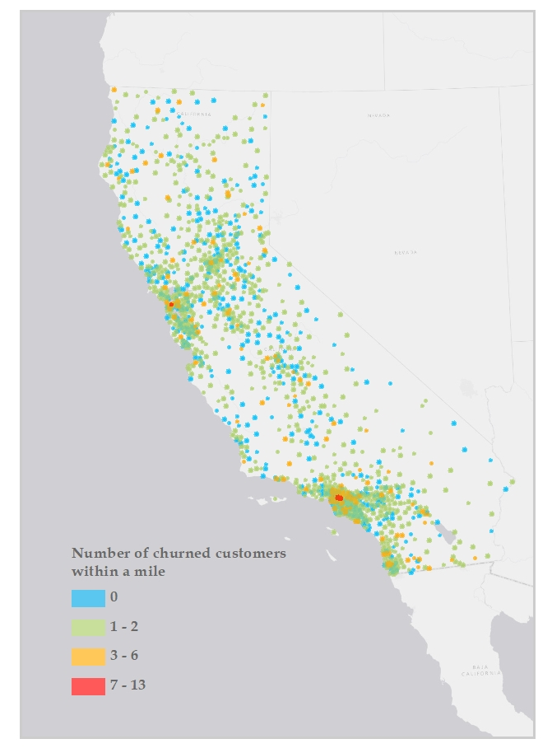
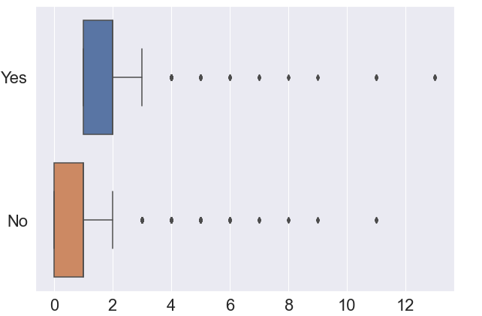
Final iteration
1. Remove correlated features
2. Engineer geographic customer information
Exploratory Data Analysis & Feature Engineering
Model Fitting & Tuning
Model Selection
Feature Importance
Hotspots of churned customers
churned
Churned
Not churned
# churned customers
within a mile
Notes:
Final model – removed correlated features, added an engineered geographic feature representing churn hotspots or the # of churn customers within a mile.
This was created in ArcGIS using buffer and spatial join tools.
In the map, you can see the location of these hotspots in orange and red.
The boxplot shows that mean # of churned customers within a mile for the churned group is higher indicating there are more churned customers close to one another.

Slide 9
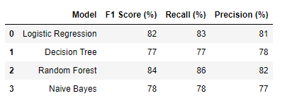
Final Iteration
No model tuning
Exploratory Data Analysis & Feature Engineering
Model Fitting & Tuning
Model Selection
Feature Importance
Correct imbalance and cross validation
With geographic feature and Total Charges removed
60% to 84%
Notes:
With removal of correlated feature and addition of hotspots, Random Forest had the strongest cross-validation performance, increasing f1 score to 84% and recall score to 86% - 86% of actual churns predicted by this model.

Slide 10
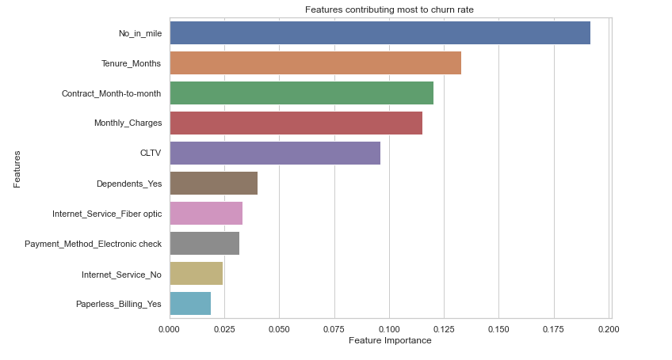
Final iteration
Top 5 features
Number churned customers within mile
Tenure (months)
Contract (month to month)
Monthly charges
Customer lifetime value
Exploratory Data Analysis & Feature Engineering
Model Fitting & Tuning
Model Selection
Feature Importance
Notes:
Top 5 features….
Some stayed same…tenure, monthly charges, and customer lifetime value (total worth to a business of a customer over the whole period of their relationship)
Changed to include churn hotspots - by far most important feature - and contract type.

Slide 11
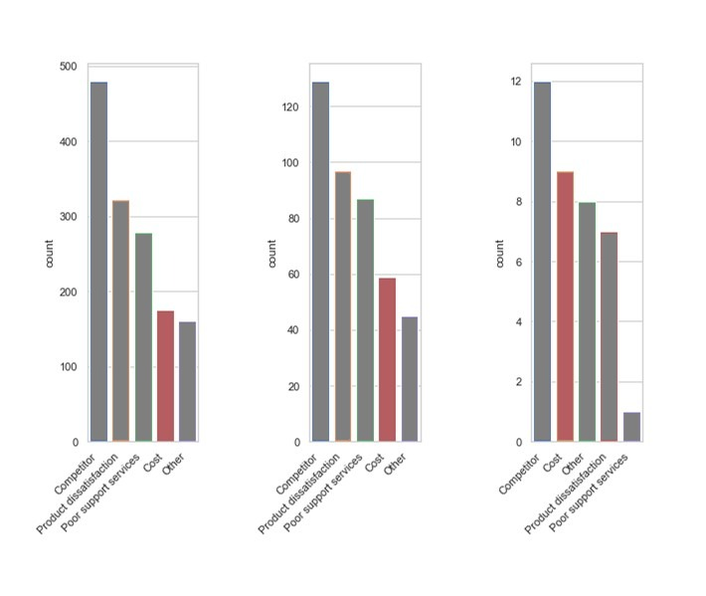
Telco business recommendations
1 to 2 churned
w/in a mile
3 to 4 churned
w/in a mile
> 5 churned
w/in a mile
Cost of products and services is more commonly given as a reason for leaving in churn hotspots
Look at minimizing installation and servicing of fiber optic to increase the return on investment that can be passed onto the customer.
Notes:
In churn hotspots cost becomes a more common reason for leaving the company
Fiber Optic is most expensive service, look at minimizing installation and servicing costs

Slide 12
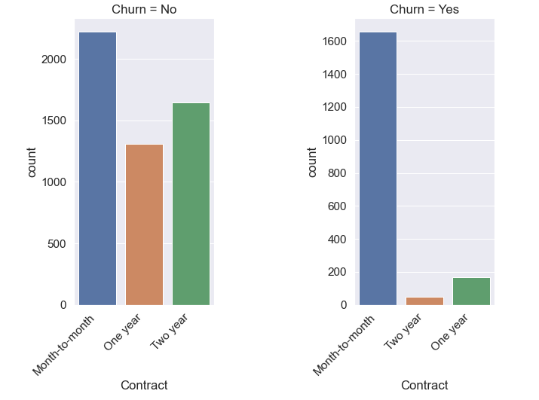
Telco business recommendations
Most churned customers have month-to-month contracts
Offer incentive packages for signing an annual or two-year contract
Notes:
Most churn customer have month to month contracts
Offer incentive for signing annual or two year contracts
One common tactic used by many SaaS companies is to decrease monthly charge if longer contracts are signed

Slide 13
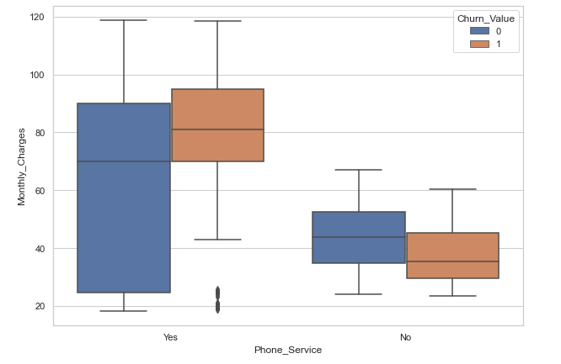
Telco business recommendations
Monthly charges are higher for churn customers with phone services
Get additional data for these customers to assess why they are paying more for standard services.
Do they have high overage charges?
Are they in areas with high taxes and fees)

Slide 14
Thank You

Slide 15
Appendix

Slide 16
Tools
Python Libraries
Pandas
numpy
Scikit-learn
GIS
- ArcGIS (buffer, spatial join)

